Slide 1

Final Engagement
Attack, Defense & Analysis of a Vulnerable Network
Aman, Ariadne, Brandon, Gabriel, Garin, Shahar

Slide 2

Table of Contents
This document contains the following resources:
01
02
03
Network Topology & Critical Vulnerabilities
Exploits Used
Methods Used to Avoid Detection

Slide 3

Network Topology
& Critical Vulnerabilities
‹#›

Slide 4
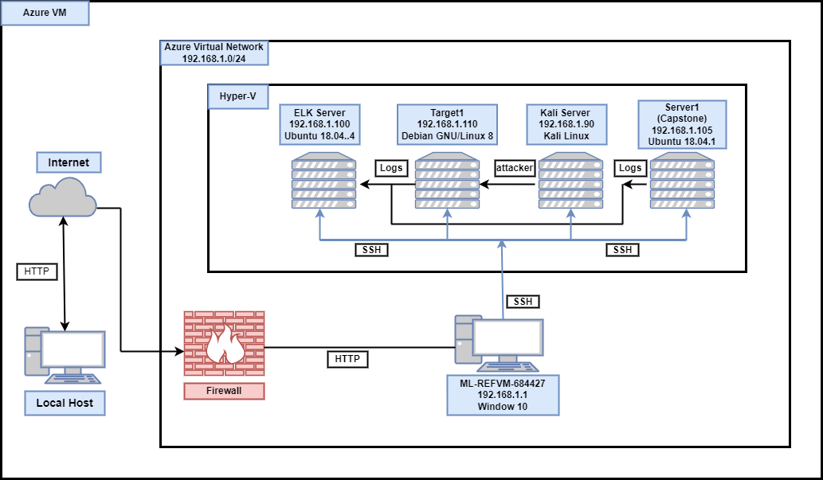
Network Topology
Network
Address Range: 192.168.1.0/24
Netmask: 255.255.255.0
Gateway: 192.168.1.1
Machines
IPv4: 192.168.1.1
OS: Window 10 Pro
Hostname: ML-REFVM-683327
IPv4: 192.168.1.90
OS: Kali Linux
Hostname: Kali
IPv4: 192.168.1.110
OS: Linux
Hostname: Target1
IPv4: 192.168.1.100
OS: Linux
Hostname: ELK

Slide 5
Critical Vulnerabilities: Target 1
Our assessment uncovered the following critical vulnerabilities in Target 1.
Vulnerability | Description | Impact
Port scanning | Use Nmap to detect open ports | Show vulnerable ports and services
Enumerate Wordpress | Using WPScan to enumerate usernames | Enumerate user account
Weak Password | Using a password that can be easily guessed or cracked | Gain access to the machine using SSH
Privilege Escalation | Using Python to gain root access by escalating privilege | Gain root access to the machine

Slide 6
Exploits Used
‹#›

Slide 7
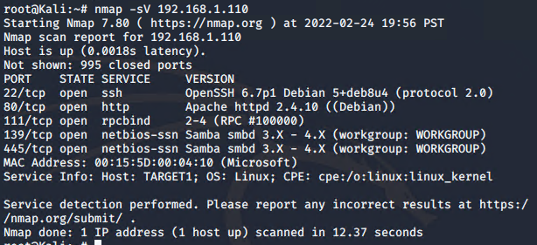
Exploitation: Port Scanning
Summarize the following:
How did you exploit the vulnerability? E.g., which tool (Nmap, etc.) or technique (XSS, etc.)?
We exploited the vulnerability by using Nmap
What did the exploit achieve? E.g., did it grant you a user shell, root access, etc.?
The exploit achieved displaying all vulnerable ports and services

Slide 8
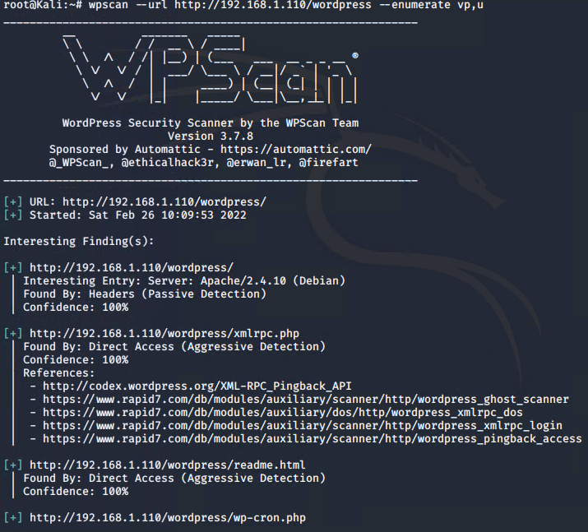
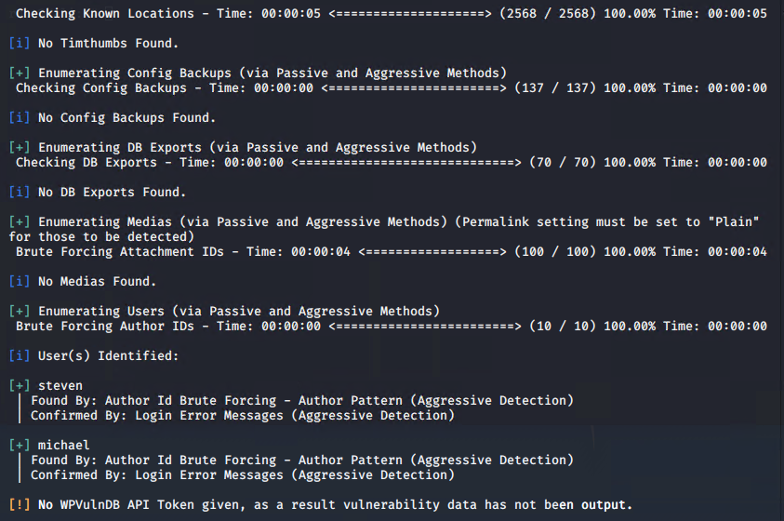
Exploitation: Enumerating Wordpress
Summarize the following:
How did you exploit the vulnerability? E.g., which tool (Nmap, etc.) or technique (XSS, etc.)?
We exploited the vulnerability by using WPScan
What did the exploit achieve? E.g., did it grant you a user shell, root access, etc.?
The exploit achieved displaying valid usernames

Slide 9
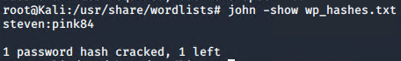
Exploitation: Weak Password
Summarize the following:
How did you exploit the vulnerability? E.g., which tool (Nmap, etc.) or technique (XSS, etc.)?
We exploited the vulnerability by using password guessing and John the Ripper to gain login credentials to SSH
What did the exploit achieve? E.g., did it grant you a user shell, root access, etc.?
The exploit granted us a user shell on the target machine

Slide 10
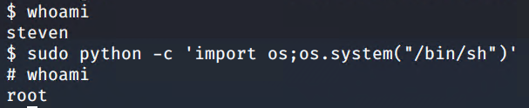
Exploitation: Privilege Escalation
Summarize the following:
How did you exploit the vulnerability? E.g., which tool (Nmap, etc.) or technique (XSS, etc.)?
We exploited the vulnerability by using Python
What did the exploit achieve? E.g., did it grant you a user shell, root access, etc.?
This exploit achieved root access to the target machine

Slide 11
Avoiding Detection
‹#›

Slide 12
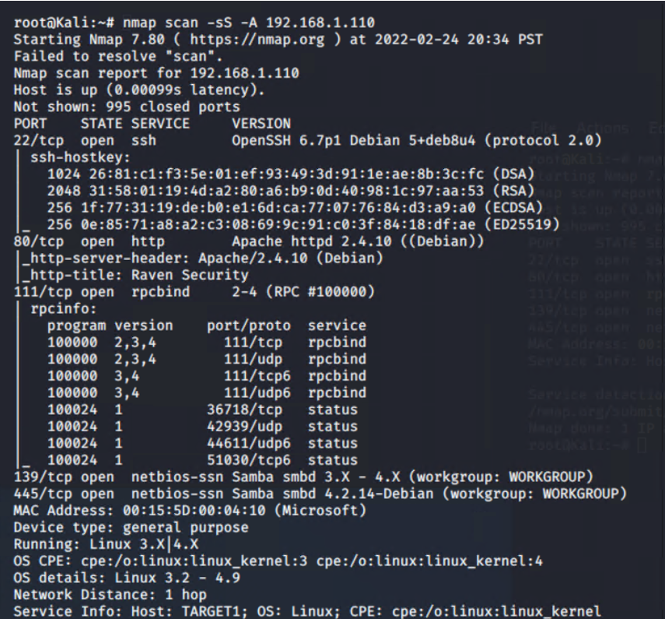
Stealth Exploitation of Port Scanning
Monitoring Overview
Which alerts detect this exploit?
HTTP Request Size
Which metrics do they measure?
Packetbeat
Which thresholds do they fire at?
>3500 in 1 minute
Mitigating Detection
How can you execute the same exploit without triggering the alert?
nmap -sS 192.168.1.110
Are there alternative exploits that may perform better?
nmap -sS -A 192.168.1.110

Slide 13
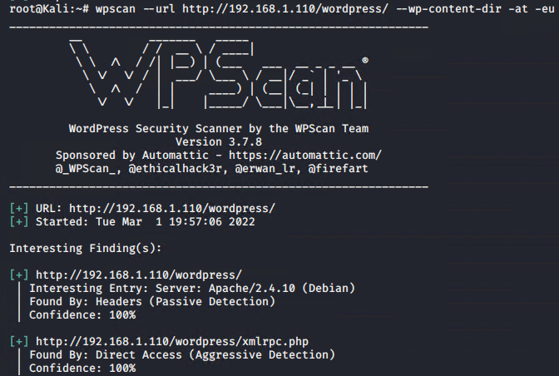
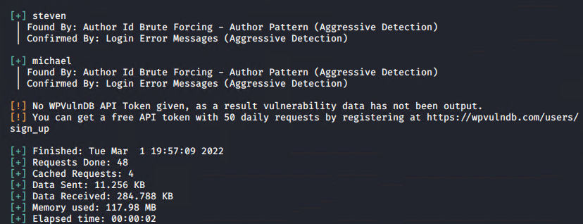
Stealth Exploitation of Enumerating WordPress
Monitoring Overview
Which alerts detect this exploit?
Excessive HTTP Errors & HTTP Request Size monitoring
Which metrics do they measure?
Packetbeat
Which thresholds do they fire at?
HTTP response code >=400 in 5 minutes & HTTP request size
>= 3500 in 1 minute
Mitigating Detection
How can you execute the same exploit without triggering the alert?
wpscan -- url http://192.168.1.110/wordpress --wp-content-dir -at -eu
Are there alternative exploits that may perform better?
wp scan is the best performing exploit to use against wordpress

Slide 14
Stealth Exploitation of Weak Passwords
Monitoring Overview
Which alerts detect this exploit?
There was no alert that was set off since we ran John on our local machine
Mitigating Detection
How can you execute the same exploit without triggering the alert?
To use John the Ripper without triggering any alerts, you would make a copy of the hashed passwords to your local machine and run John the Ripper there
Are there alternative exploits that may perform better?
We can use Hashcat rather than John the Ripper to crack the password. Hashcat can be configured to use the GPUs (rather than CPU) of the machine

